Slide 1
My Family Health Portrait (MFHP) – HealthVault Import/Export Project
Status of Inception Phase
Prepared for
The Department of Health & Human Services &
The National Cancer Institute
July 13, 2009

Slide 2
Agenda
Objectives & Status
Gap Analysis
  Issues
  Solutions
  Conclusions
Outline of Implementation Plan
Risks

Slide 3
Objectives of Project – Problem Statement
The Surgeon General released MFHP 2.0 to improve inter-operability by enabling users to easily transfer family health history to other systems. But the user must store information to and retrieve from his/her own system, significantly limiting inter-operability. Enabling a user to store information to a secure system such as Microsoft HealthVault would address these limitations.

Slide 4
Objectives of Inception Phase
Proposed
Status
Define scope of development
Analyze gaps between MFHP 2.0 & HealthVault
Develop implementation plan and budget
Revised Vision, detailed Use Cases, & developed authentication requirements
Identified gaps & developed solutions
Plan outlined for HHS/NCI consideration

Slide 5
Gap Analysis: Issues
1. Mismatch of HV person/records to MFHP Relatives – Critical
2. Handling conditions data of Multiple 3rd Party HealthVault Applications – Significant
3. Importing into MFHP multiple coded values for a condition – Significant
4. Mis-matches of Date & Age Range – Low
5. Mis-matches of Ethnicity & Race - Low

Slide 6
Gap Analysis:
Issue 1: Mis-match of HV Person/Record to MFHP Relative
3 inter-related manifestations
  1-1 HV does not maintain a family tree
  1-2 HV’s de-normalized system forces one to add a family member a second time to list a second condition for that family member
  1-3 HV has diseases/conditions without specifying the relative with the disease/condition

Slide 7
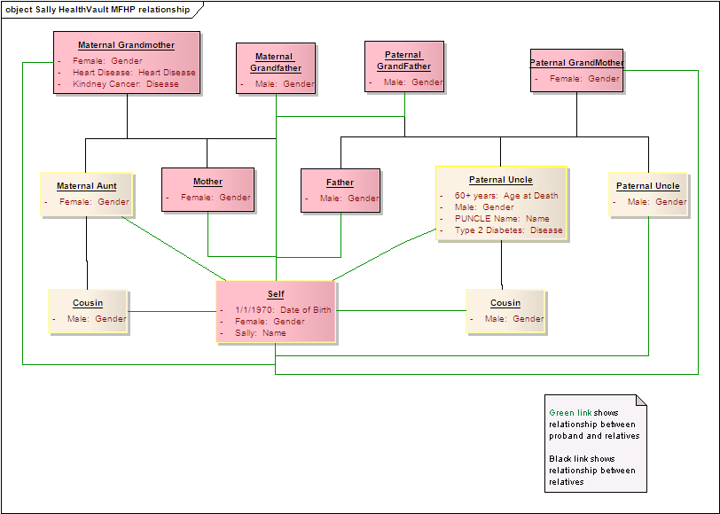
Gap Analysis
Issue 1-1: MFHP’s Family Tree Structure
Relatives relate to each other
Sally is in context of her relatives via a foreign key called “ID Extention”

Slide 8
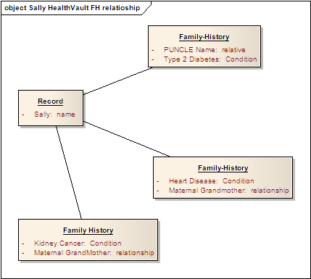
Gap Analysis
Issue 1-1: HealthVault’s Flat Structure
All records lead to Sally -- no relatives relate to each other
  There is no HV family tree for MFHP to interact with

Slide 9
Issue 1-2: In HV, to add a 2nd condition, must add a 2nd FH
Family History
  Paternal Uncle
  Kidney Cancer
Family History
  Paternal Uncle
  Heart Disease
Family History
  Diabetes Type 2
Sally
Paternal Uncle has Heart Disease – to add Kidney Cancer for him, one must add Paternal Uncle again
Relationship & Name are optional
Can’t determine if one relative with multiple conditions or multiple relatives each with one condition

Slide 10
Issue 1-3: Mis-Match on Optional Information
MFHP
HV
Relative
Condition
Condition
Relative
MFHP requires a relative to receive data – HV may not have it
HV requires a condition to receive data – MFHP may not have it

Slide 11
Gap Analysis
Solutions to Issue 1
HV enables a family tree
  Relate relatives to other relatives with a “Relative ID,” an analog to MFHP’s “ID Extention”
  Microsoft has agreed to this change
HV enables a relative to have 0 to multiple conditions
  Microsoft has agreed to change
  Mayo Clinic has agreed to change (must confirm)

Slide 12
Gap Analysis: Issue 2:
Importing conditions data of Multiple 3rd-party HV Apps
Which coding schema does the app use?
  How to ID a condition not in MFHP?
  Relationship to SNOMED code in MFHP? (Issue 3)
Solutions
  Text-match HV data to MFHP data
  Add un-matched HV condition data to MFHP “other”/pick-list
Future Possibility
  HV service to automatically interpret data through a coding system the user requests to use
  2010?

Slide 13
Gap Analysis: Issue 3:
Importing multiple coded values for a single condition
How does MFHP recognize a 2nd coded value is really a synonym of 1st coded value?
  Or a sub-set or generalization of the 1st coded value
Potential Solutions
  Augment MFHP to support multiple codes per condition
  Use 1st condition but persist conditions 2 – N conditions in MFHP for re-export
  Future HV data interpreter

Slide 14
Gap Analysis: Issue 4:
Mis-Matches of Date & Age Range
Age of Person
  MFHP has 2 schema -- for Living & Deceased
    Living – Date of Birth or Current Age (user’s selection persists)
    Deceased – Age Range of Death or Age Categories (Infant, Adolescent, et al)
  HV uses Date of Birth & Date of Death
Diagnosis v. Condition
  MFHP has Diagnosis; HV has Condition
  MFHP has Age Range of Diagnosis & Undefined Age Categories
  HV has Date Started and Date Ended for conditions
Possible Solutions
  MFHP specifies dates and years for birth, death, diagnosis & condition
    MFHP consciously omits birthdates of deceased
  Use HV extensions to store diagnosis timing, age ranges & categories

Slide 15
Gap Analysis: Issue 5:
Mis-Matches of Ethnicity & Race
MFHP’s Ethnicity/Race covers the proband and all relatives, while HealthVault’s Ethnicity covers only the account holder
MFHP has attributes Ethnicity and Race, while HV has only Ethnicity (for account holder only - see below)
HealthVault has Ethnicity values with no match in MFHP – Mixed Race and Other Race
HealthVault lacks an Ethnicity value for “Ashkenazi Jewish”
Potential Solutions
  Use HV extensions to store ethnicity/race of relatives
  HV agreed to add Ethnicity value of “Ashkenazi Jewish
  MFHP adds “Mixed Race” and “Other Race” values

Slide 16
Conclusions of Gap Analysis
MFHP-HV Import/Export is feasible
  On critical issues, Microsoft & Mayo Clinic agreed to change
  On other issues, potential solutions identified
    Both HV & MFHP will need to change
Necessity of critical HV & Mayo changes complicates implementation
  Deployment of HV & Mayo changes in Oct/Nov 2009 at earliest
  HV agreed to concept of parallel development
    HV to give MFHP access to its early HV builds in test environment
    Meet to resolve issues as needed

Slide 17
Implementation Plan Outline
Phase 1: Initial development & org arrangement
  Establish software interaction with HV app
  Set up parallel development with HV organization
  Monitor HV organization’s progress on critical changes
Phase 2: Develop MFHP Export/Import with HV
  Translate MFHP FHH to HV History Items
  UI to save to HV
  Augment MFHP’s handling of non-coded data
  Test against HV’s new build in HV test environment
Phase 3: Beta test
  With real users if possible
Phase 4: Deployment
  Support NCI Deployment Team as needed

Slide 18
Risks
Dependency on HV
  Coordinating an effective development schedule
  HV on schedule to add changes
  Receiving technical support as needed
  Handling unknown changes to HV’s beta app
Unknown dependency on Mayo Clinic or other HV apps
Interoperability Testing
Assuaging others’ concerns about authentication
Coordination of NCI and Microsoft help desk support fails to gel

Slide 19
Discussion Points
Is the outline of the plan sensible?
Are the risks acceptable?
Deliveries on July 15
  Scope: revised vision, use case model and use cases
  Gap analysis
  Implementation Plan
    Tasks
    Estimated schedule & budget

